Slide 1
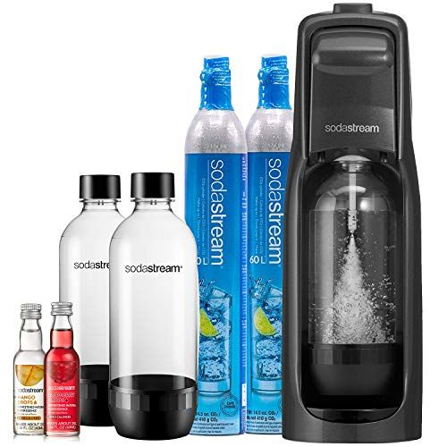
PepsiCo Challenge

Slide 2
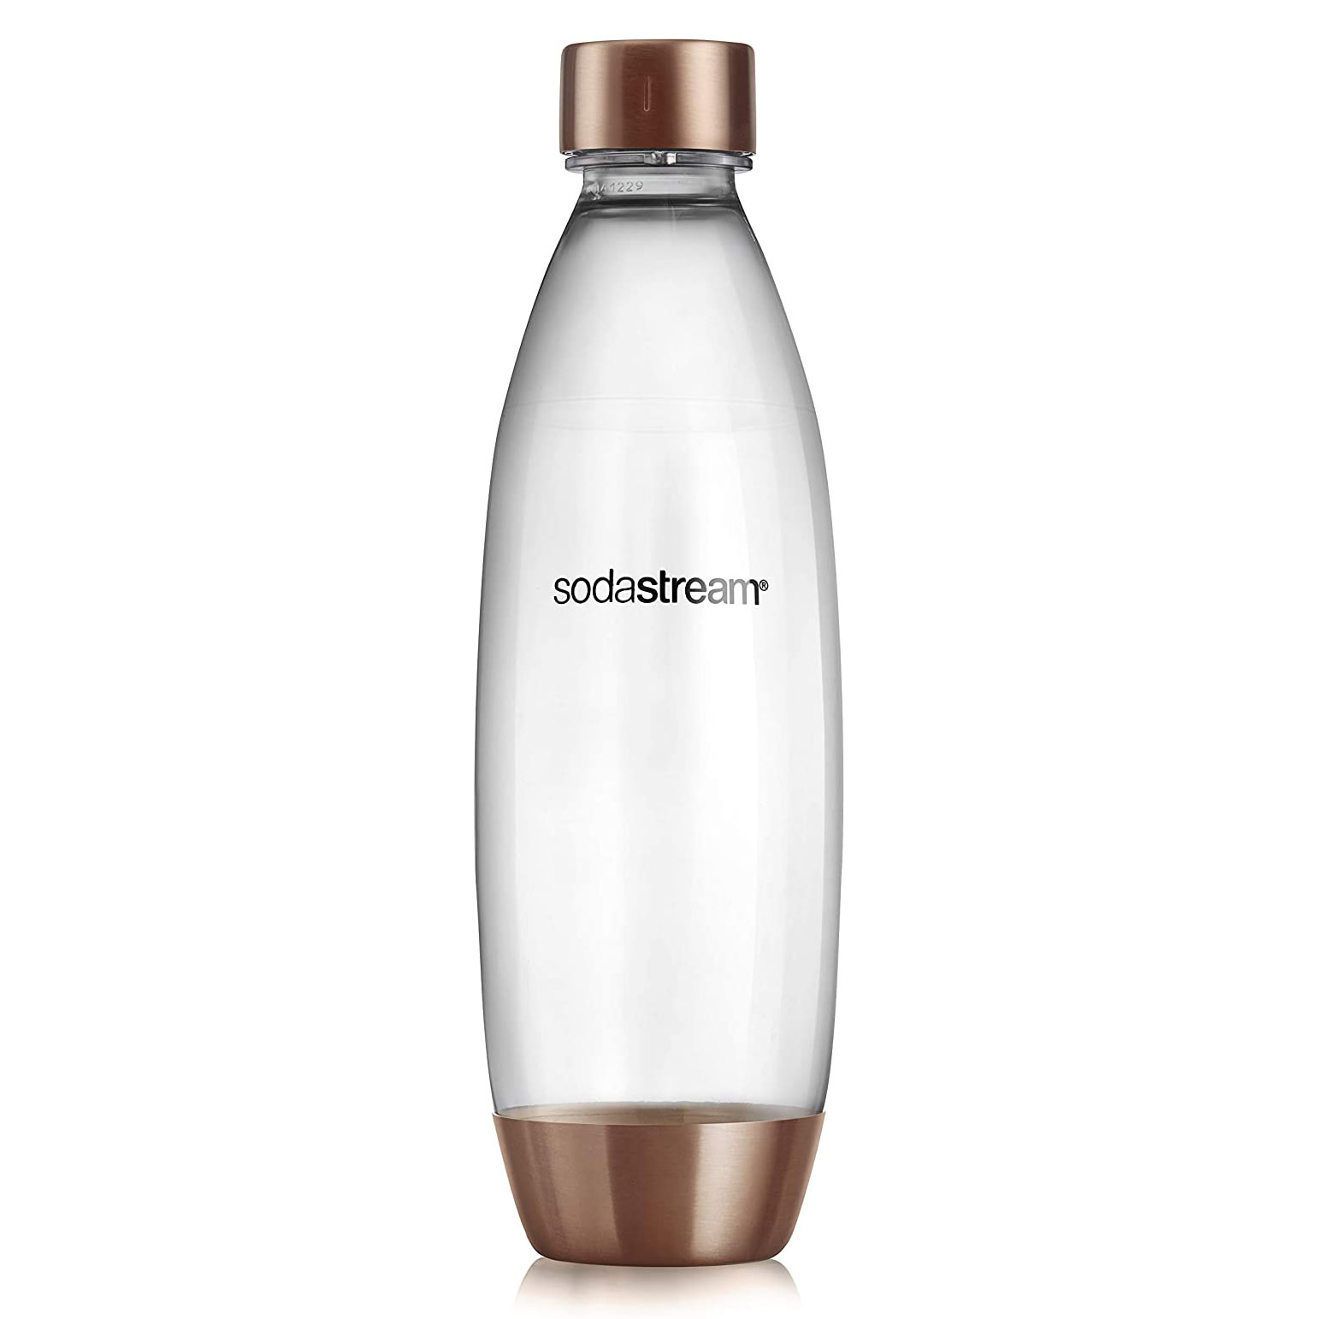
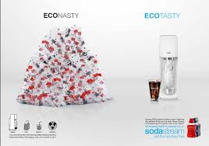
The Reusable and Sleek Option
Why not use reusable bottles for carbonated drinks as well?
Saves 3,000 disposable bottles annually
Reduces carbon footprint by 87%

Slide 3
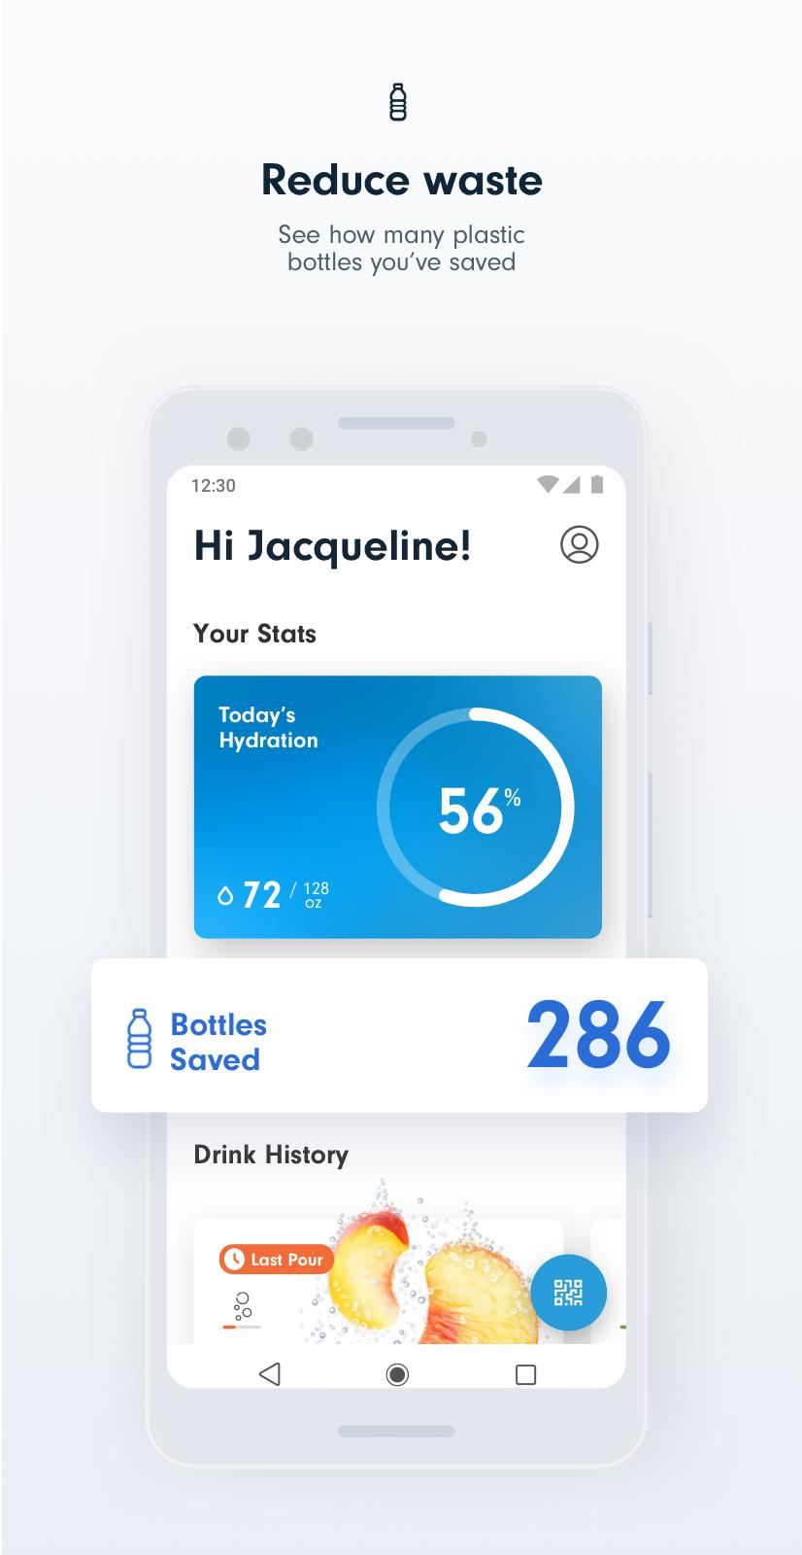
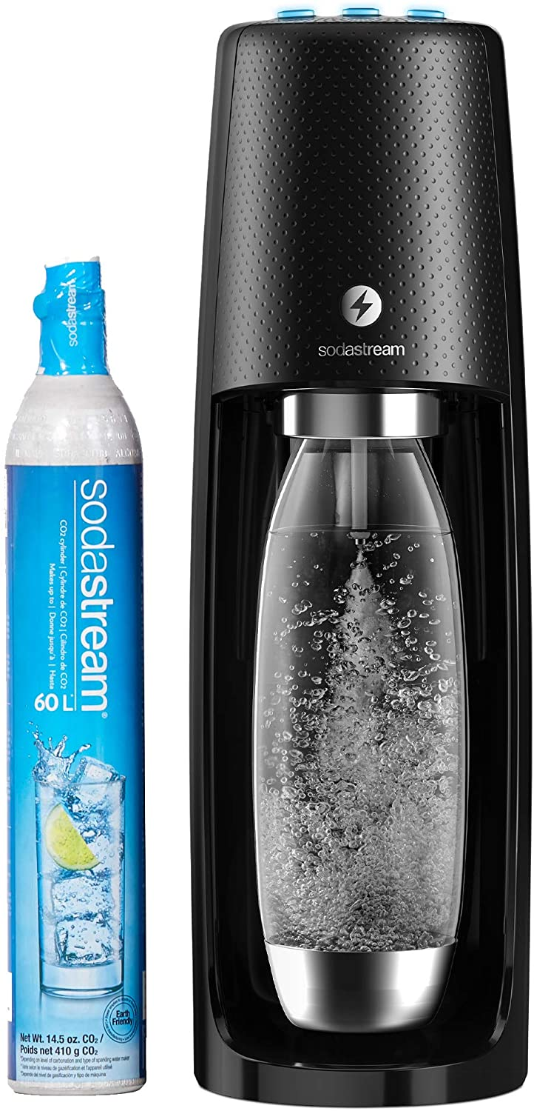
The Ideal SodaStream Unboxing Experience
You have just arrived at your college/university and you receive your very own SodaStream for your dorm!
With unlimited personal usage in your dorm and with SodaStream accessible around campus, you are free to enjoy your flavored and carbonated beverages 24/7.
Also, with the SodaStream connect app you track your hydration, save your favorite drinks, and see how many plastic bottles you have saved.

Slide 4
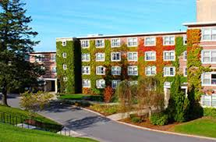
How To Keep Students Engaged
Dorm challenge
Competition between dorms for who uses the SodaStream the most/saves the most single-use plastic bottles
Individual and Community Goals will be set for how many plastic bottles were saved
Prizes offered for reaching these goals:
Favorite Flavor Refill per month
Woo Sox Tickets
And many more…
VS
Notes:
Prize: Not only to get students engaged month to month to reuse their soda stream, but the chance to have a fun night in the worcester community at the woo sox game
Because smiley would be happy smiling with the lower carbon footprint
Prizes will be handled on the basis of first, second and third place and can get continually greater with the grand total (end of year) amount of plastic bottle saved

Slide 5
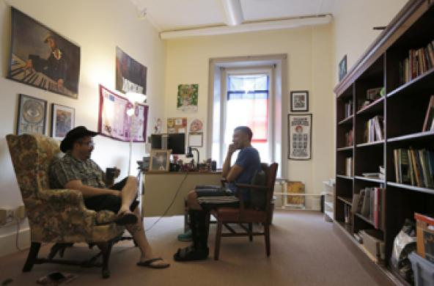
Campus Engagement
Involving Campus Organizations
Give Sodastream products to student organizations to then giveaway as gifts or prizes.
Provide flavor packets to professors to distribute to their students.
Notes:
Sodastream flavor packets as prizes at Bingo night at Crossroads.
Flavor packet giveaway at Companion House
Treats to give out to students who visit during office hours.

Slide 6
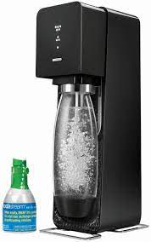
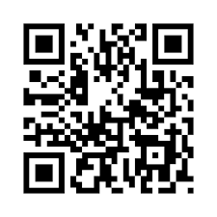
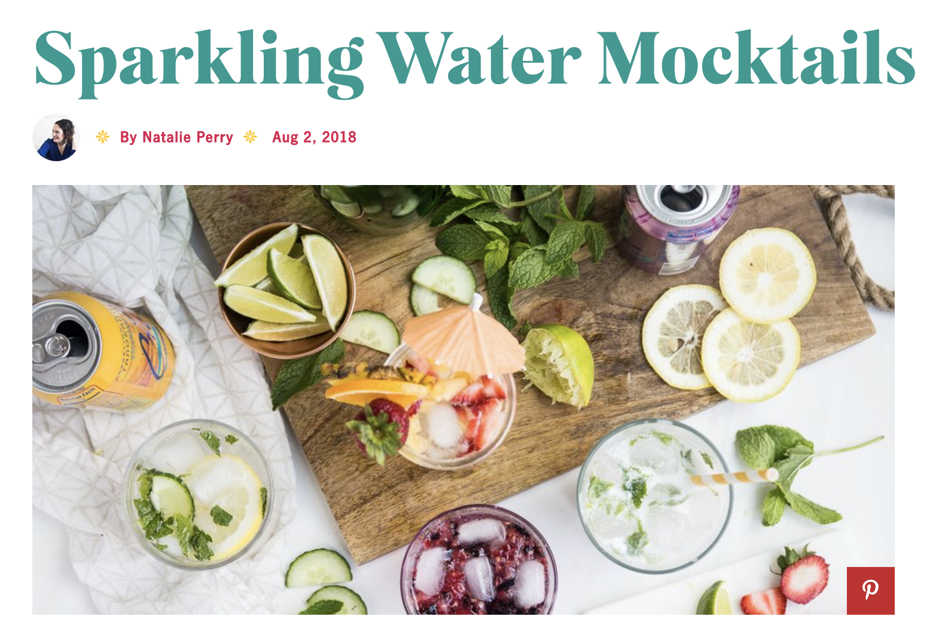
Creative Engagement
QR codes
A scannable code on the product that links to a social media page where students can give and get inspiration on flavor combinations or recipes for other drinks in which carbonated water is used

Slide 7
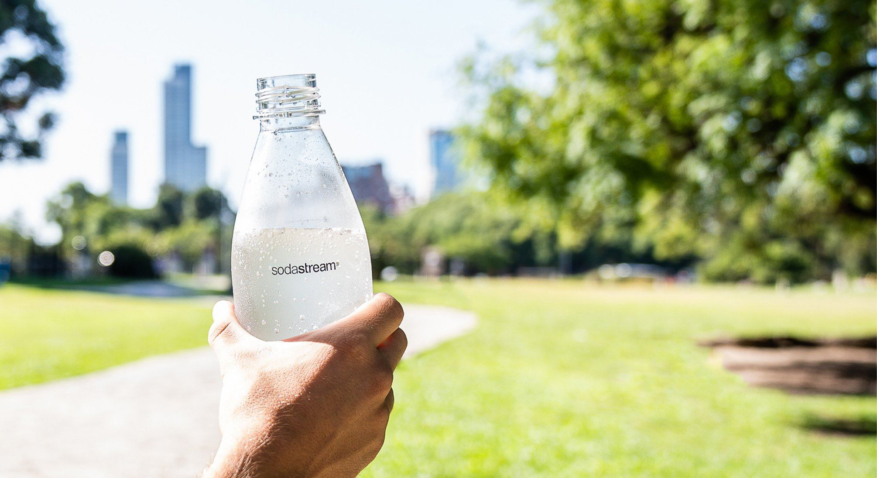
Thank you.
#lesswastemoresparkle
“Get busy with the fizzy” on the Hill

